Slide 1
GreenSock
Autumn 2020

Slide 2
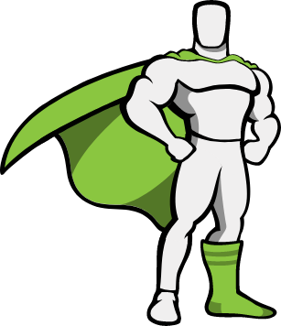
What it is
Basically a plugin for making animations.
A bit (a lot) like jQuery.animate
Slowly becoming less and less relevant, as CSS and SVG works better and better across browsers.
There isn't much you can do with (basic) GreenSock, that you couldn't as easily do with CSS.
But you'll see it a lot, and it is (still) fun to play with!

Slide 3
TweenMax - a quick note
Greensock has recently (november 2019) been released in version 3 - now there is ONE api for everything (+ plugins)
Previously one would use TweenMax or TweenLite, and TimelineMax or TimelineLite.
Not anymore - now everything is just called gsap. If you see example-code using TweenMax or any of the above, just replace TweenMax with gsap in your code!
See more differences: https://greensock.com/3-release-notes

Slide 4
How to get it
https://greensock.com/docs/v3/Installation
Usually you should use CDN, but you can also install it locally, even with NPM
Mostly you'll only need GSAP (core) - but we'll look into some of the plugins too.
Note, that there are two classes of plugins, the free ones, and the paid ones, called Club Plugins. You don't need, and can't use the paid plugins!

Slide 5
Quick example
The general structure of an animation is always like this:
gsap.to( target, { properties } )
Properties are values to be animated: x, y, rotation, opacity, etc. Or values to control the animation: duration, delay, ease, etc.
QuerySelector element to be animated
Object with properties and values to animate (to or from)

Slide 6
Exercises
Now, do these two exercises, found in Fronter:
Exercise – Greensock animation 1
Exercise – Greensock animation 2
Refer to https://greensock.com/get-started for tips and tricks to get going!

Slide 8
Special properties
In addition to animatable properties (and their shortforms) there are some special control properties:
duration - always needed
delay - if you want to wait a bit with this animation
onComplete - a function to be called when the animation ends
ease - the easing to use … there are several different
stagger - individual delays, as you just tried
yoyo - used with repeat, alternates direction
repeat - number of times the animation should run
See more at https://greensock.com/docs/v3/GSAP/Tween

Slide 9
Tweens and Timelines
A tween is a single animation.
Calling .to, .from or .fromTo creates a Tween object.
All animations happen at the same time, every .to or .from starts at the same time (unless you specify a delay).
A timeline is a sequence of animations - every .to or .from is added to the timeline, and each one runs after the previous one finished
See more at https://greensock.com/docs/v3/GSAP/Timeline

Slide 10
Timeline exercise
Now do the timeline exercise:
Exercise – Greensock animation 3

Slide 11
Plugins
MotionPath - for moving along a path – possible in CSS with offset-path
Draggable - helps with some physics on interactivity
Easel - with EaselJS (createJS), if you use that for canvas manipulation
Pixi - with PixiJS, if you use that for canvas manipulation
EasePack - Easings – if you want to create custom easings
CSSRule - helps with CSS animations
ScrollTo - helps with scrolling-animations
Text - helps with text changing animations

Slide 12
The way to learn is to experiment
https://greensock.com/docs/v3/GSAP gives great docs
But it is always easier to find an example on CodePen, and then use the docs to understand what is going on.
Remember, if you see TweenMax or something like that, it is just GSAP2.0 or earlier, and will still work when replaced with gsap!

